Slide 1
CSE291 - Introduction To Software Engineering (FALL 2022)
Data Flow Diagram (DFD)

Slide 2
Behavioural Models
Behavioural models are used to describe the overall behaviour of a system.
Two types of behavioural model are:
Data processing models that show how data is processed as it moves through the system
State machine models that show how the systems respond to events.

Slide 3
Data Flow Diagram (DFD)
The distinguishing features of DFDs are as follows:
Data flow diagrams capture the flow of data in a system.
It describes data origination, transformations and consumption in a system.

Slide 4
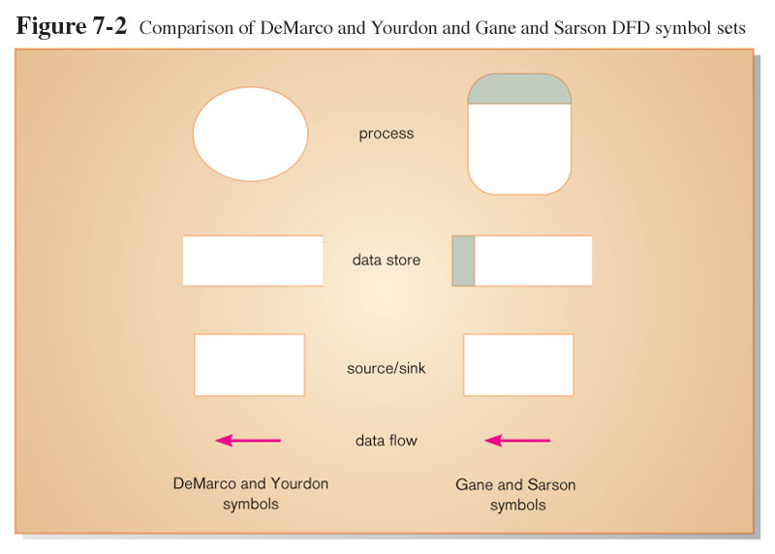
The DFD Notation

Slide 5
DFD Components
DFDs consist of four basic components that illustrate how data flows in a system: entity, process, data store, and data flow.
Process: work or actions performed on data (inside the system).
Data Store: Data at rest (inside the system).
Source/ Sink: External entity that is origin or destination of data (outside the system).
Data flow: arrows depicting movement of data.

Slide 6
DFD Components
Entity:
An entity is the source or destination of data. The source in a DFD represents these entities that are outside the context of the system. Entities either provide data to the system (referred to as a source) or receive data from it (referred to as a sink).
Process:
The process is the manipulation or work that transforms data. In other words, a process receives input and generates some output. Process names (simple verbs, such as “Submit Payment” or “Get Invoice”).

Slide 7
DFD Components
Data Store:
A data store is where a process stores data for later retrieval by that same process or another one. Files and tables are considered data stores. Data store names are simple but meaningful, such as “customers,” “orders,” and “products.”
Data Flow:
Data flow is the movement of data between the entity, the process, and the data store. Data flow portrays the interface between the components of the DFD.

Slide 8
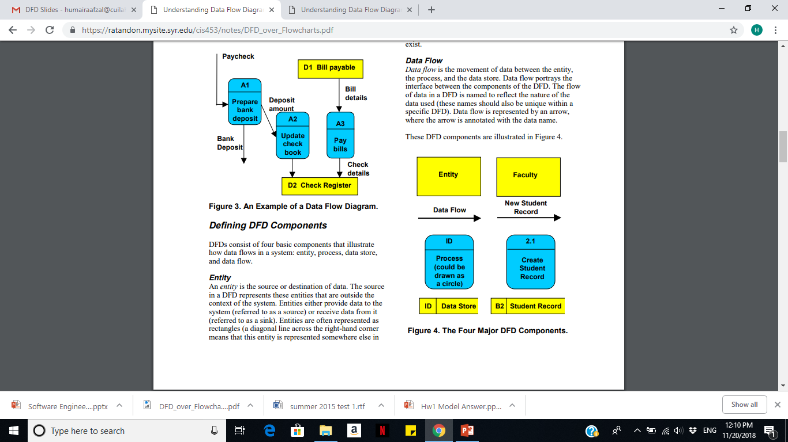
DFD Components

Slide 9
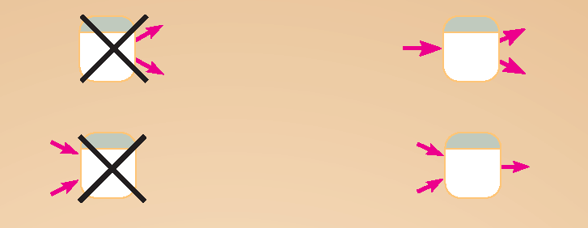
DFD Diagramming Rules (Process)
No process can have only outputs or only inputs. Processes must have both outputs and inputs.
Process labels should be verb phrases.

Slide 10
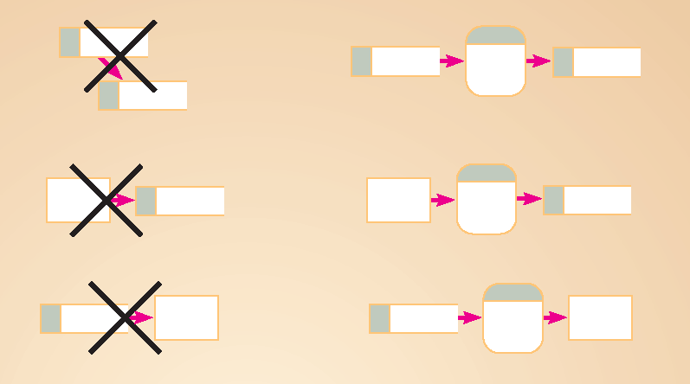
DFD Diagramming Rules (Data Stores)
All flows to or from a data store must move through a process.
Data Store labels should be noun phrases.

Slide 11

DFD Diagramming Rules (Source/Sink)
No data moves directly between external entities without going through a process.
Source and Sink labels should be noun phrases.

Slide 12
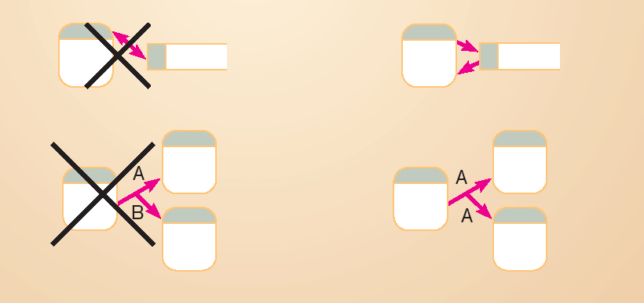
DFD Diagramming Rules (Dataflow)
Bidirectional flow between process and data store is represented by two separate arrows.

Slide 13
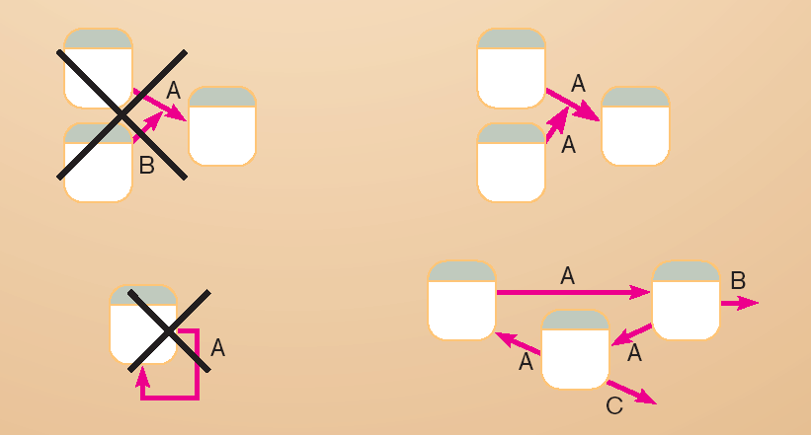
DFD Diagramming Rules (Dataflow)
Data flow cannot go directly from a process to itself, must go through intervening processes.

Slide 14
DFD Diagramming Rules (Dataflow)
Data flow from a process to a data store means update (insert, delete or change).
Data flow from a data store to a process means retrieve or use.

Slide 15
DFD Levels
Context / Level-0 DFD
Level 1DFD
Level- 2 DFD
Level-n DFD

Slide 16
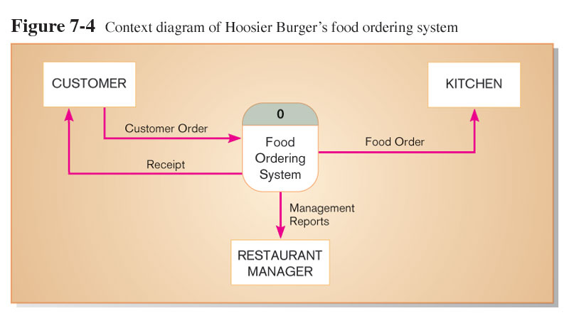
Context Diagram of Burger’s food ordering system
Context diagram shows the system boundaries, external entities that interact with the system, and major information flows between entities and the system.
NOTE: only one process symbol

Slide 17
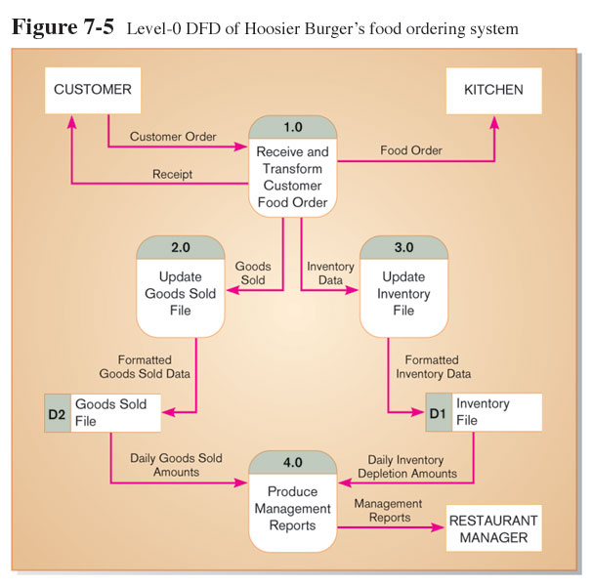
Level-1 DFD
Level-1 DFD shows the system’s major processes, data flows, and data stores at a high level of abstraction.
Processes are labeled 1.0, 2.0, etc. These will be decomposed into more primitive (lower-level) DFDs.

Slide 18
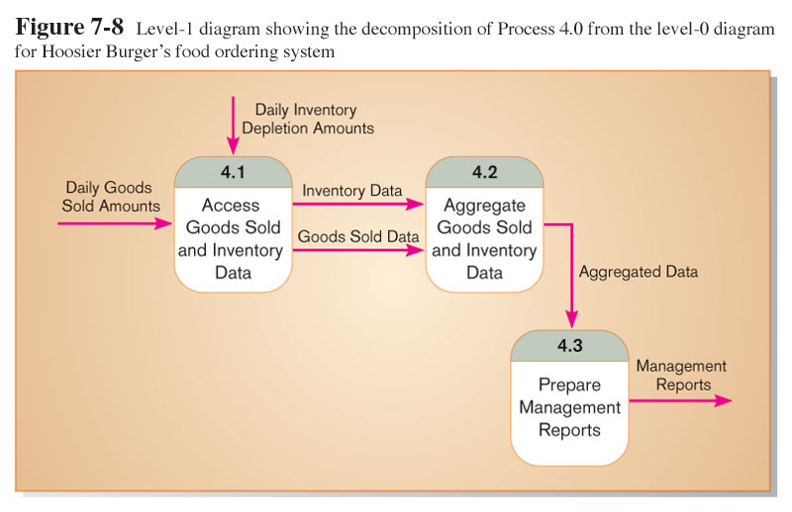
Level-2 DFD
Level-1 DFD shows the sub-processes of one of the processes in the Level-0 DFD.
This is a Level-1 DFD for Process 4.0.
Processes are labeled 4.1, 4.2, etc. These can be further decomposed in more primitive (lower-level) DFDs if necessary.

Slide 19
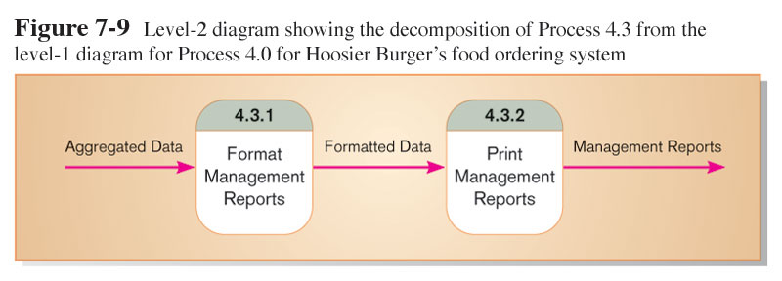
Level-n DFD
Level-n DFD shows the sub-processes of one of the processes in the Level n-1 DFD.
This is a Level-3 DFD for Process 4.3.
Processes are labeled 4.3.1, 4.3.2, etc. If this is the lowest level of the hierarchy, it is called a primitive DFD.

Slide 20
Case Study
Draw a context level data flow diagram for a patient monitoring system.
Process of patient monitoring system:
A patient’s vital signs are transmitted to this system, which may invoke a warning message to the nurse if these signs fall into the critical range. Nurse may request for a report, which the patient monitoring system retrieves from the patient log, and returns it to the nurse again.

Slide 21
Exercise 1: Consider the following case study and answer the questions written at the end of text.
“ Pizza Express wants to install a new software system to record orders for take-away pizza. When customers call Pizza Express on the phone, they are asked about their data and order details. Once the order is taken the total cost (including delivery and any applicable discount) is calculated. A receipt is printed. The order is then given to the chef to make the pizza. Occasionally, special offers (coupons) are printed so that the customer can get a discount. Order details are kept for comparison with last year’s performance.”
Draw the DFD Level 1 Diagram for the above scenario.

Slide 22
Exercise 2
Consider a mail order company that distributes CDs and tapes at discount prices to its members.
When an order processing clerk receives an order form, she verifies that the sender is a member by checking the MEMBER FILE.
If the customer is a member, the clerk verifies the order item data by checking the ITEM FILE.
Then the clerk enters the order data and saves it to the DAIILY ORDERS FILE.
At the same time the clerk also prints an invoice and shipping list for each order, which are forwarded to the ORDER FULFILLMENT DEPARTMENT for processing there.
Draw the Context Level DFD and DFD Level 1 Diagram for the above scenario.

Slide 23
Exercise
Draw Level 0 and Level1 DFD of Your assigned Projects

Slide 24
State machine models
A state machine model describes how a system responds to internal or external events.
It shows a system states and events that cause transitions from one state to another. It does not show the flow of data within system.
This type of model is often used for modelling real-time systems because these systems are often driven by stimuli from the system’s environment.
For example, the real-time alarm system responds to stimuli from movement sensors, door opening sensors, and so on.

Slide 25
State machine models
A state machine model of a system assumes that, at any time, the system is in one of a number of possible states.
When a stimulus is received, this may trigger a transition to a different state.
For example, a system controlling a valve may move from a state ‘Valve open’ to a state ‘Valve closed’ when an operator command (the stimulus) is received.

Slide 26
Elements of State chart
Initial State
Final State
Transition
Idle
Running
State

Slide 27
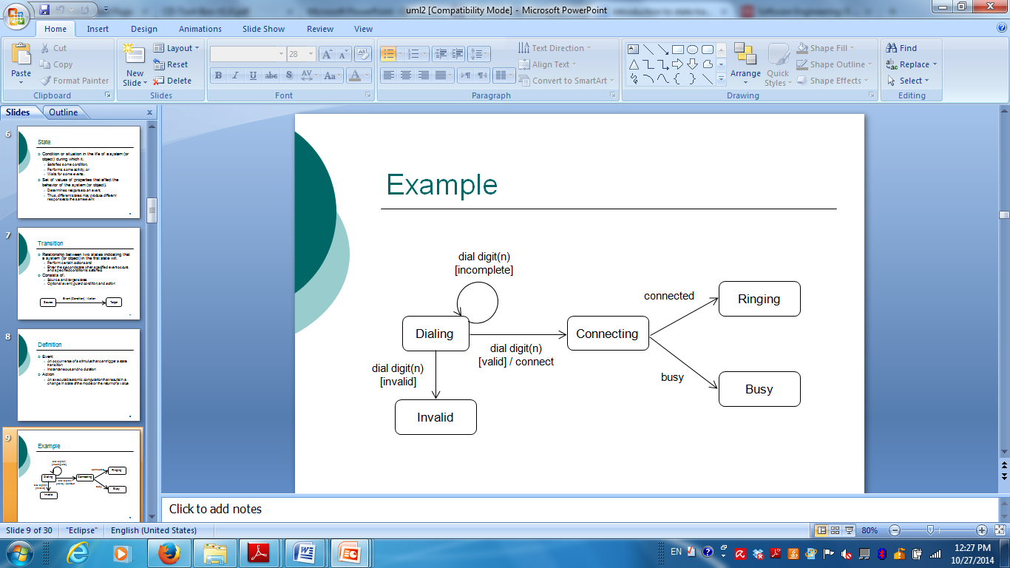
Example

